Slide 1

Driver sleep detection
system
Smart Drowsiness Detection Wearable
Eminence 5.0 – Innovative Idea Challenge
Team Code: EM24 | Team Name: Astra
Team Members: Sasanthi , Himansha , Oshini , Irasha

Slide 2

The Drowsy Driver Crisis
Road accidents caused by driver fatigue and drowsiness claim thousands of lives annually, making it a pressing global issue.
Long-haul professionals like bus, truck, and taxi drivers often succumb to sleep without realizing it, endangering everyone on the road.
Current solutions fall short:
Camera-based systems are costly and impractical for everyday use, while harsh loud alarms can startle drivers into panic.
There's an urgent need for a low-cost, portable, and non-intrusive tool that detects drowsiness early and responds calmly.

Slide 3

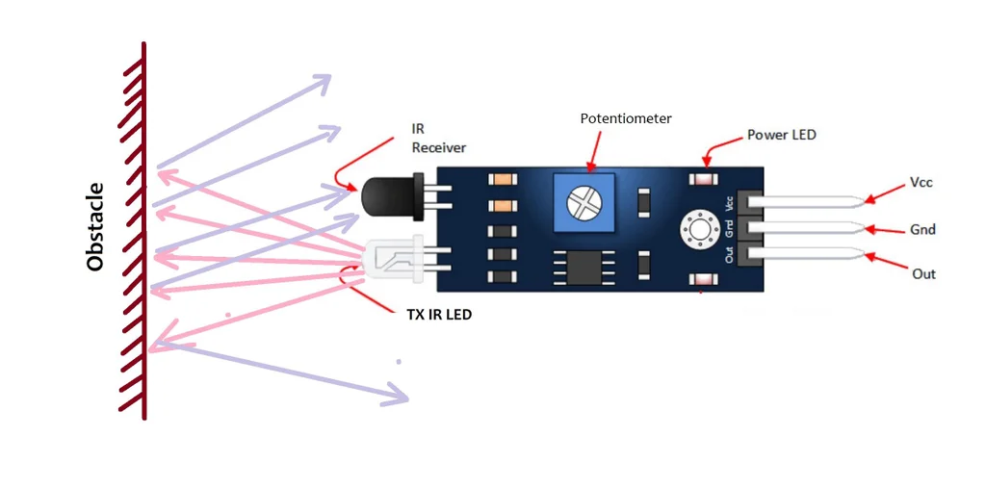
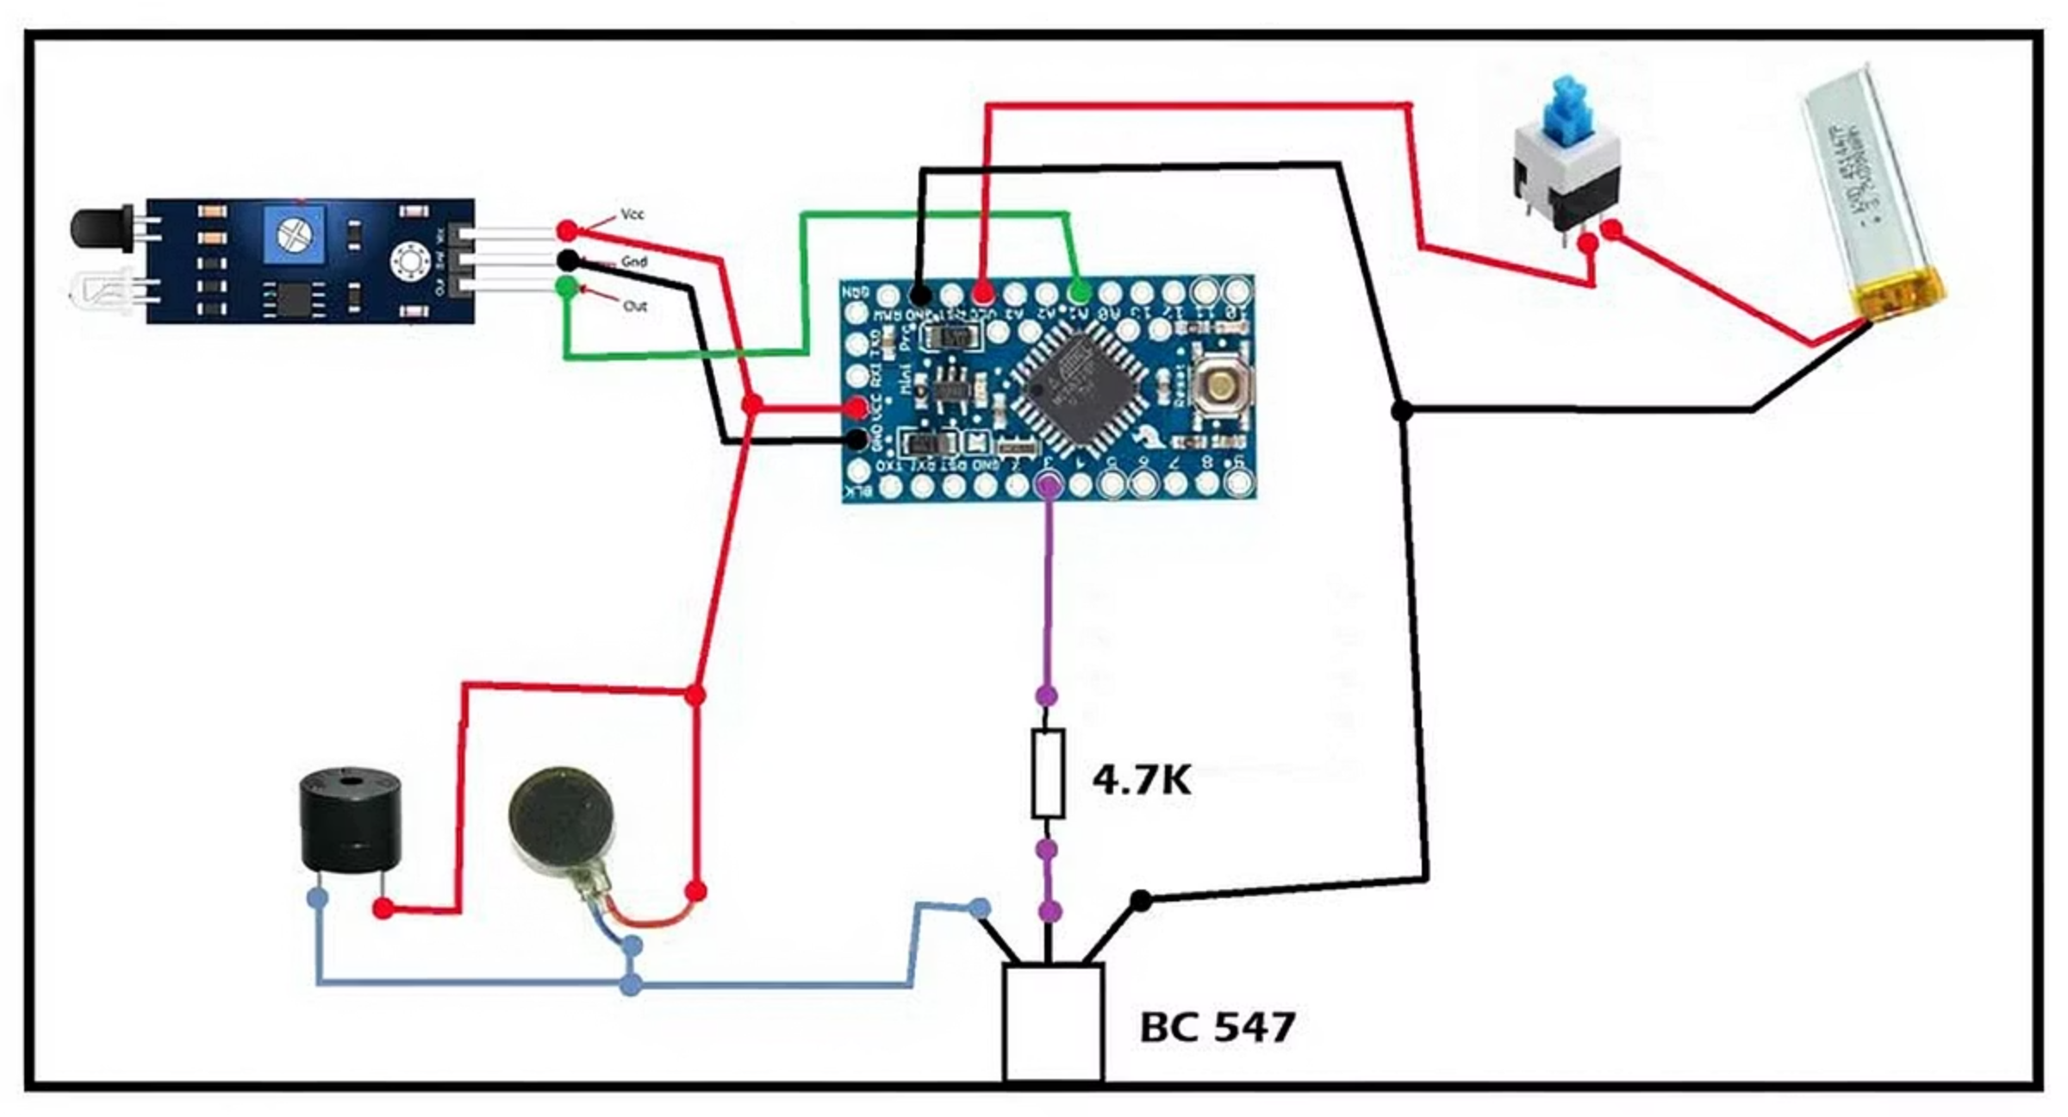
Innovative Wearable Solution
1
2
Comfortable Design
Core Equipment
A lightweight glasses frame that integrates seamlessly, worn comfortably for hours without distraction.
IR sensor tracks eye closure patterns
Arduino Pro Mini processes data
5V buzzer and vibrator provide gentle alerts
BC547 transistor and 4.7kΩ resistors manage power
3.7V rechargeable battery ensures portability
3
Key Features
Affordable and simple to build, this device works universally across any driver or vehicle.
It's non-intrusive, detecting subtle signs of fatigue before they become dangerous.

Slide 4
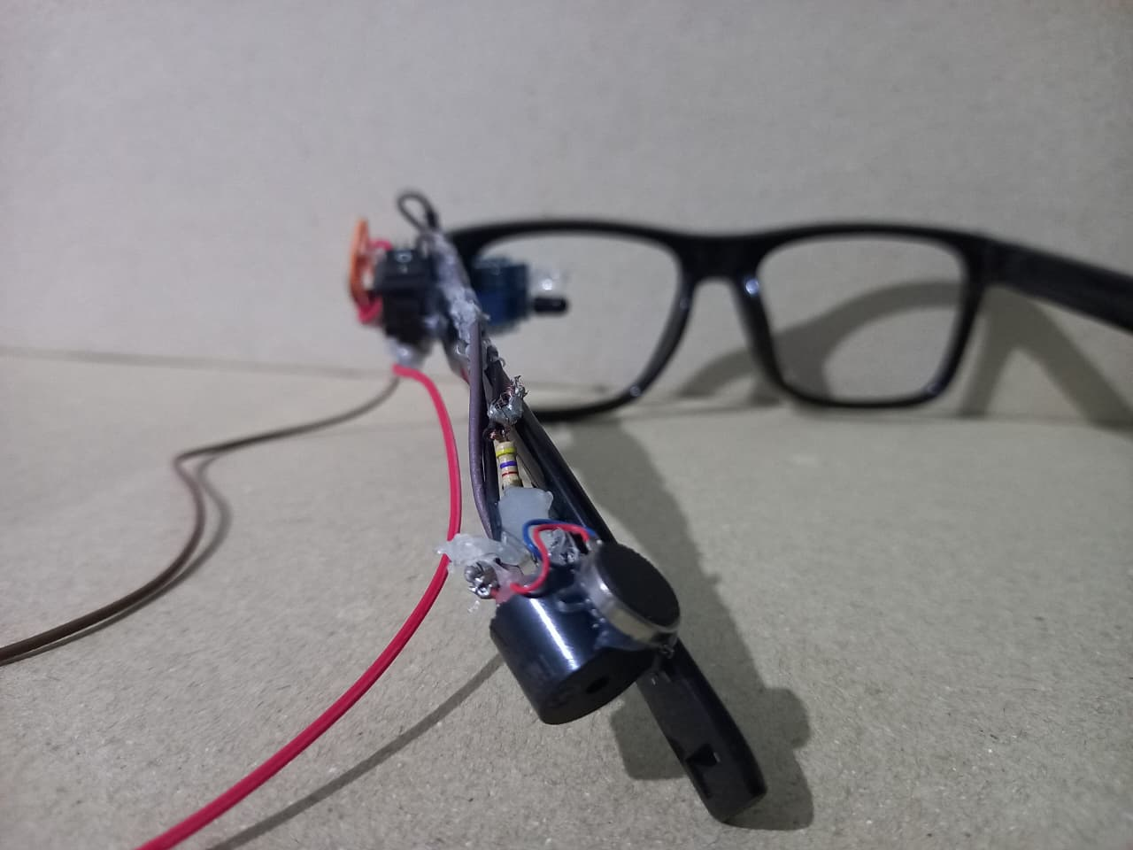
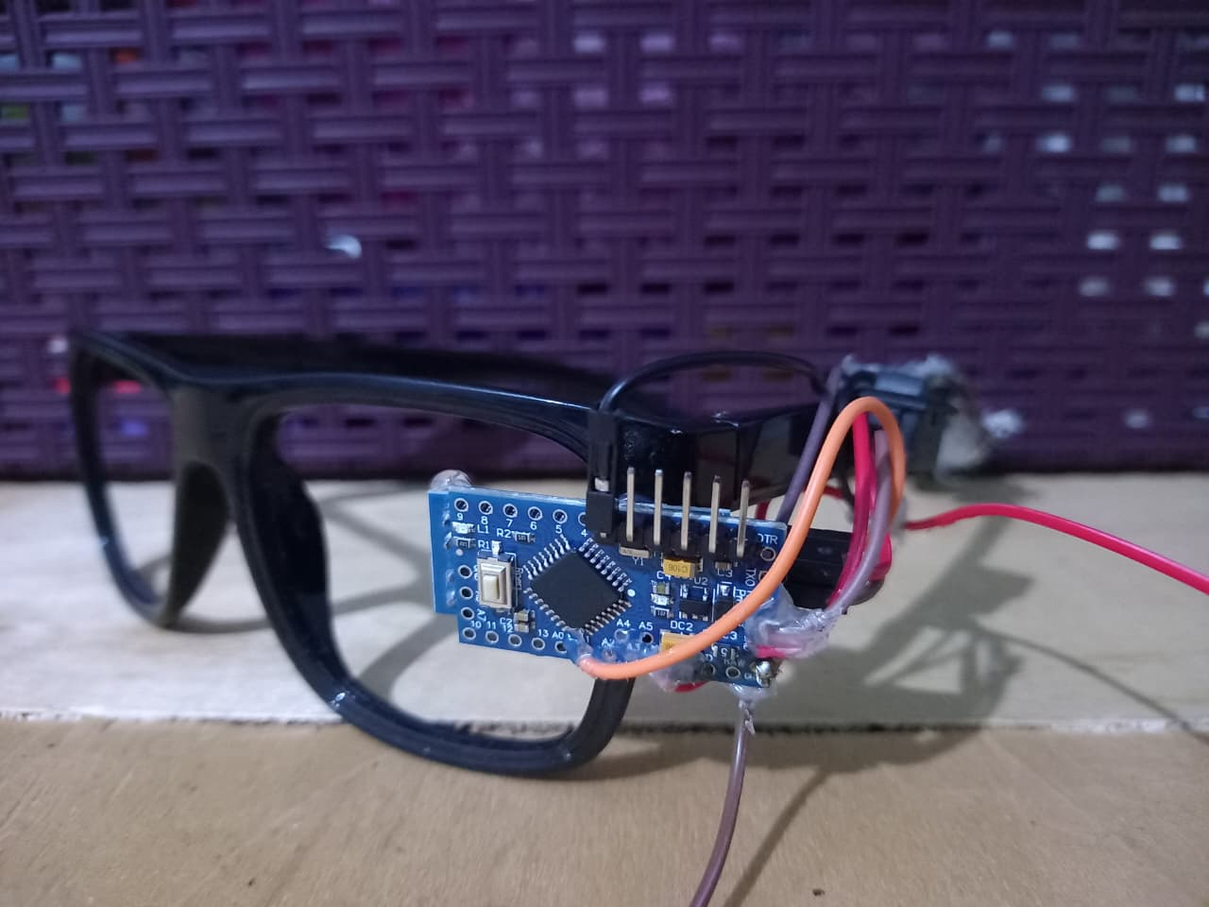
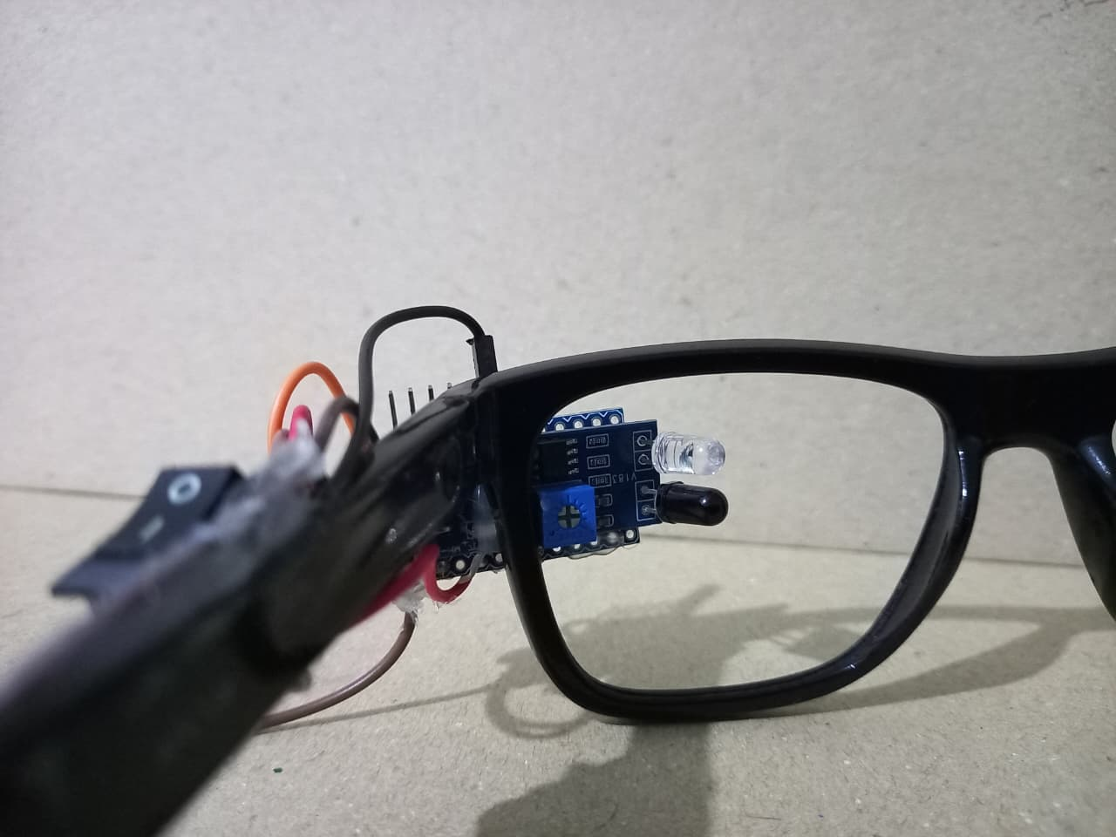

Slide 5

Objectives and Lasting Impact
Target Audience
Focused on high-risk groups: long-distance bus and truck operators, taxi drivers, and private vehicle owners who face extended hours behind the wheel.
Expected Outcomes
A fully functional prototype that reliably detects eye closure and triggers timely alerts, proving real-world viability.
Value Proposition
Engineered for safety, it prevents fatigue-induced crashes while being low-cost and adaptable to diverse needs.
Impact: Transforming roads into safer spaces, reducing accidents, and ultimately saving countless lives through proactive drowsiness prevention.

Slide 6
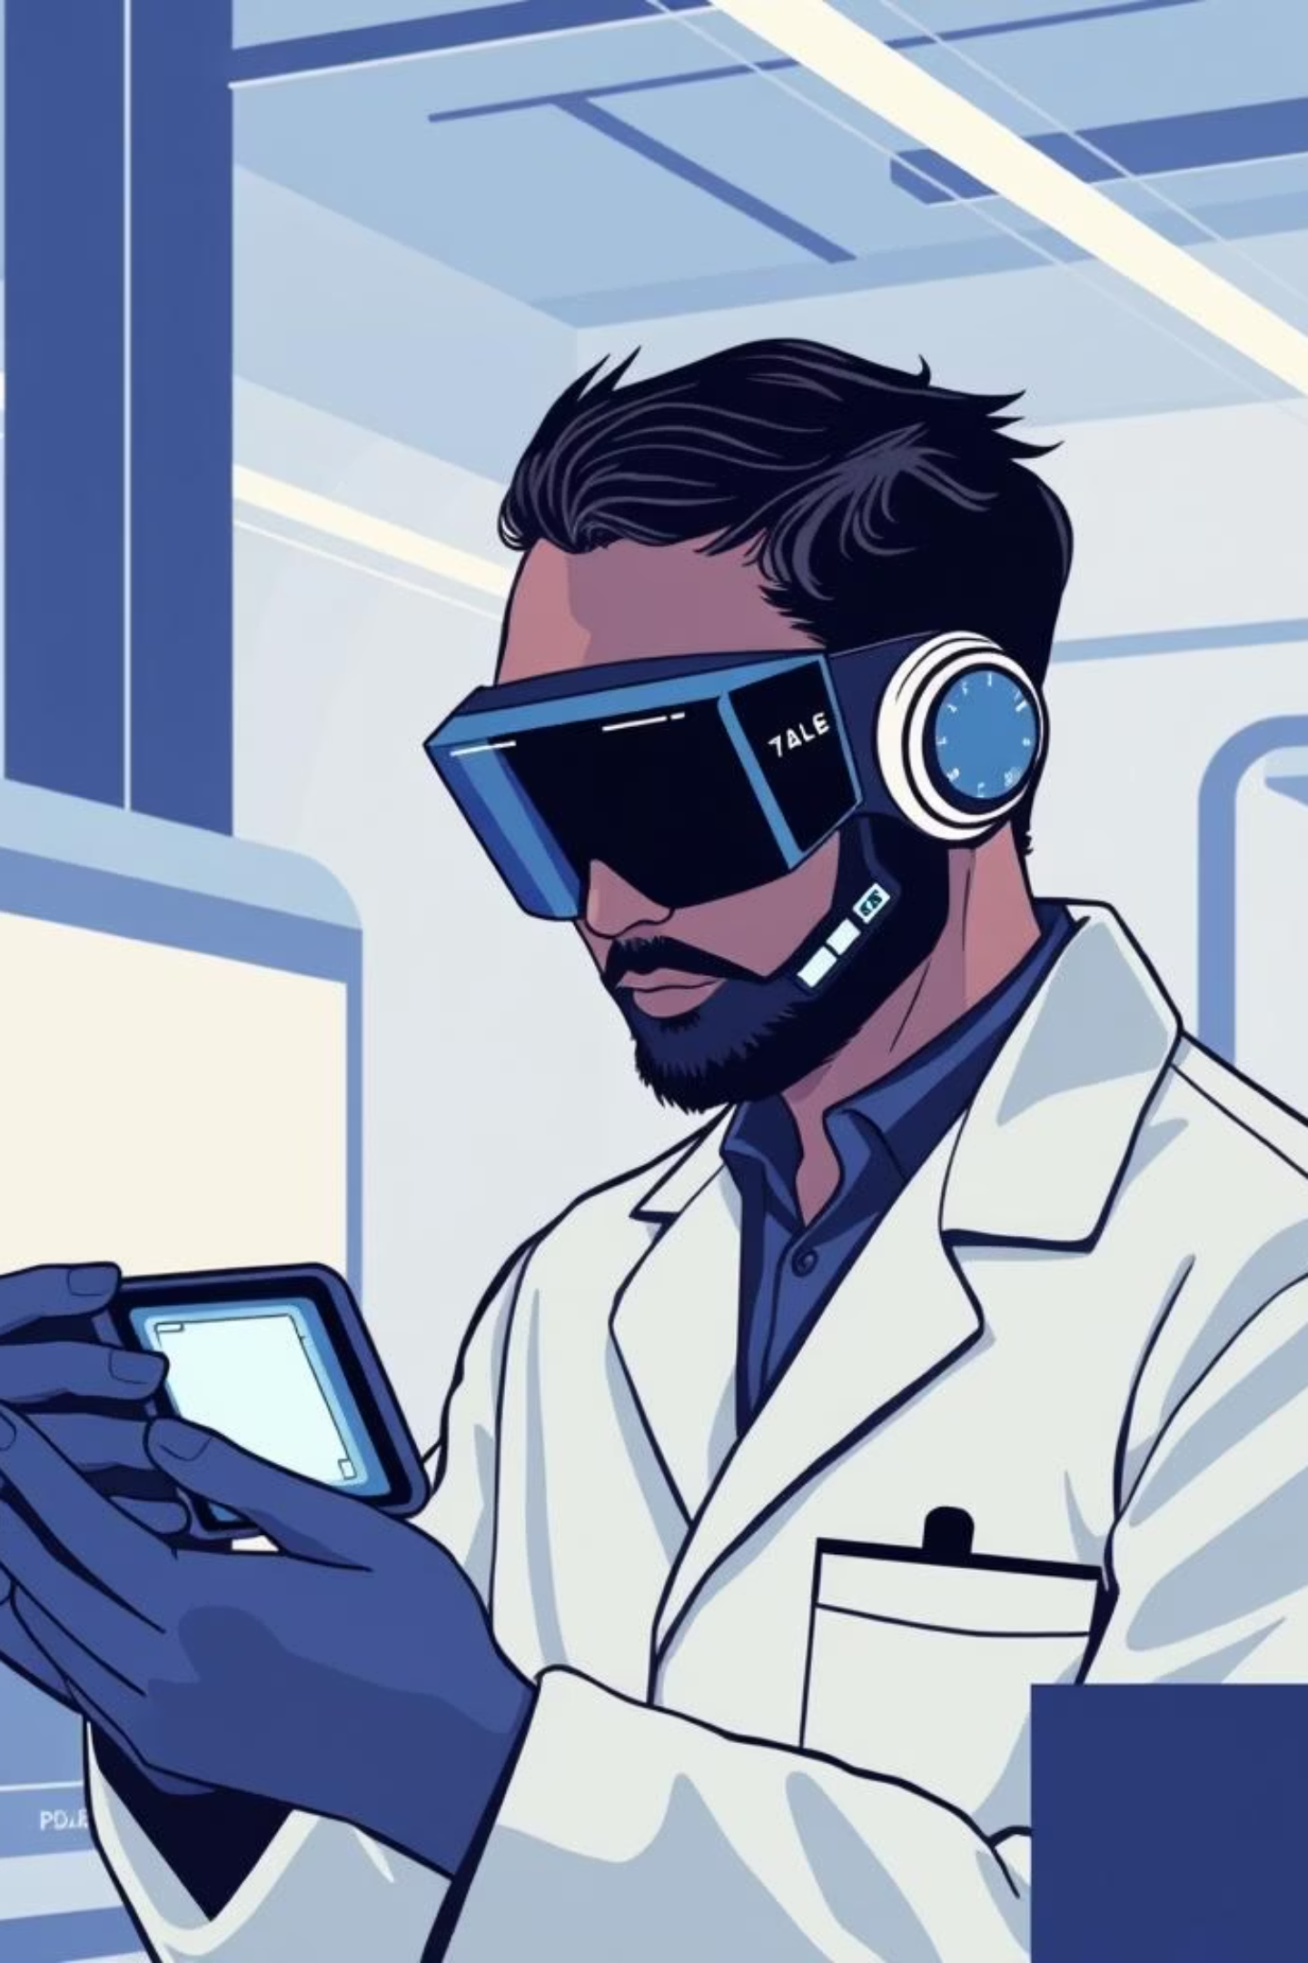


Feasibility and Future Horizons
Proven Feasibility
Leveraging affordable, readily available components like IR sensors, Arduino pro mini , buzzers, and batteries.
The straightforward circuit design enables quick prototyping, with tasks efficiently divided among our four team members for seamless development.
Future Enhancements
Integrate Bluetooth for real-time alerts to family or fleet managers
Add advanced vibration motors for silent notifications
Incorporate AI for precise eye movement analysis
Enable smart vehicle links like automatic braking or lane assistance

Slide 7

Thank You

